Slide 1
My library @ bsu
By Todd Vandenbark

Slide 2
Background
The term “My Library” coined in 1997 by Eric Lease Morgan, Keith Morgan, and Doris Sigil at NCSU
Began as an open-source, turnkey application, with a MySQL database and Perl program modules
Concept popular, & software downloaded and installed in nearly two dozen libraries

Slide 3
Drawbacks
Did not fare well in usability tests
Adoption rarely exceeded 10% of potential users
Tended not to customize
Result: only lasted 5 years at NCSU

Slide 4
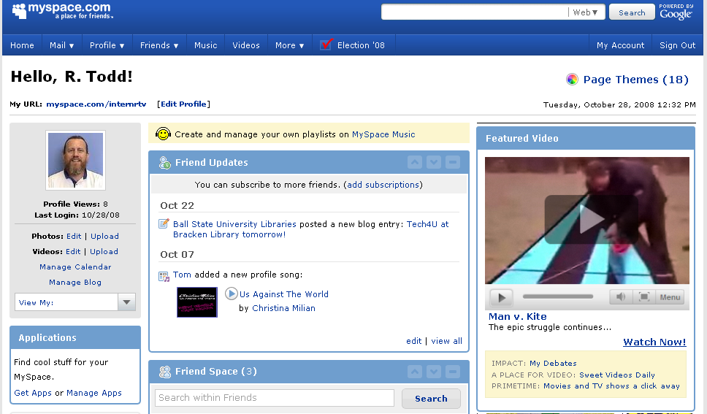
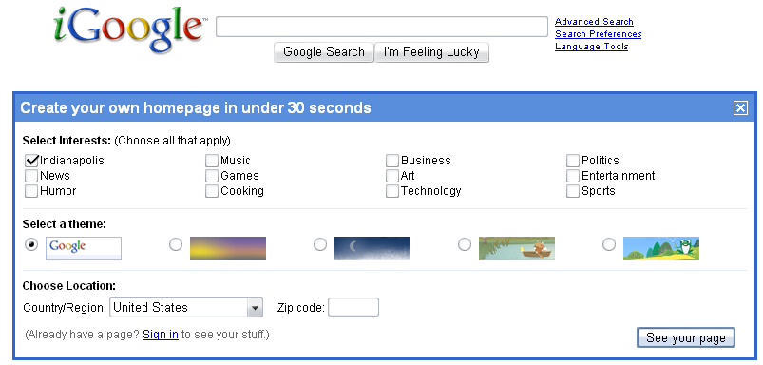
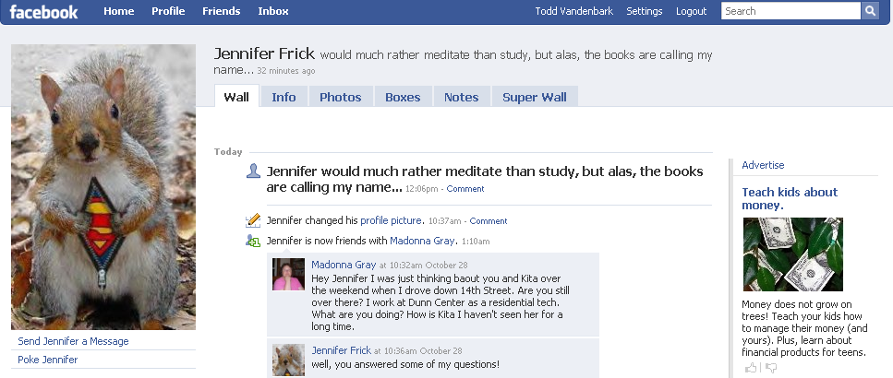
Yet…
People do personalize
My Yahoo!
iGoogle
MySpace
Facebook

Slide 5
Goals:
Provide patrons with tools and services that are:
Tailored to their needs
Web-based
Accessible 24 x 7
Intuitive, i.e. “Don’t make me think!”
Such services must also:
Utilize and promote existing resources
Avoid increasing workload on library staff
Be supported by management

Slide 6
Research
Phase I: existing MyLibrary implementations
NCSU
Mississippi State Univ.
Cornell
Univ. of IL @ Chicago
University of Rochester “CoURse Resources and Reserves”
Notes:
NCSU features:
Patron account
My course reserves (for courses currently enrolled in)
My Alerts: emails with TOC of selected journals, with links to full text when available
RefWorks: web-based citation management
Miss. State Univ. features:
Electronic indexes/databases
Internet resources
Video and DVD searches
Patron record
Electronic reserve
Auto-fill online forms
Cornell:
My Contents: journal TOC via email in any format, including EndNote, Ref. Mgr, and html
My Document Delivery: may request print collection items as PDFs
Patron account
Bookbag: list of items saved from library catalog for later request/retrieval
RefWorks account
U of Rochester: course resources and reserves for classes by class

Slide 7
Research
Phase II: Professional input and advice
Eric Lease Morgan, formerly at NCSU, now at Notre Dame
Provided helpful resources
Susan Gibbs at the University of Rochester
Hired a programmer to create a My Library widget for Blackboard
Notes:
Eric Lease Morgan
Received copy of soon-to-be-published article which provided detailed background and information.
Gave 4 more My Library implementations still running
Explained structure of facet-term combinations
[click slide]
Susan Gibbs, Vice Provost, UR
Used to have My Library for course reserves, and all students had to go through it to get them.
Hired a programmer to create a My Library widget for Bb

Slide 8
Design
Notes:
Working with Robert Seaton, programmer, the basic My Library package available on Notre Dame’s site would have required extensive customization, so we chose to build it from scratch:
Todd: XHTML, CSS, and accessibilty
Robert: programming with MySQL and PHP, and contacts with LibGuides provider to obtain them in XML format.

Slide 9
Layout

Slide 12
Development
MyLibrary is still under development on a secure section of the library’s server.
It’s a prototype, and not a finished product.
If you ask Brad nicely, maybe he will sign in and demonstrate…
http://libix.bsu.edu/mylibrary/

